Slide 1
Agile tools
Project tools
Communication tools
CI
Varga Levente
Levente_Varga1@epam.com
<EPAM Systems>
CONFIDENTIAL | © 2022 EPAM Systems, Inc.

Slide 2
Lookback to the Agile methodology basics

Slide 3
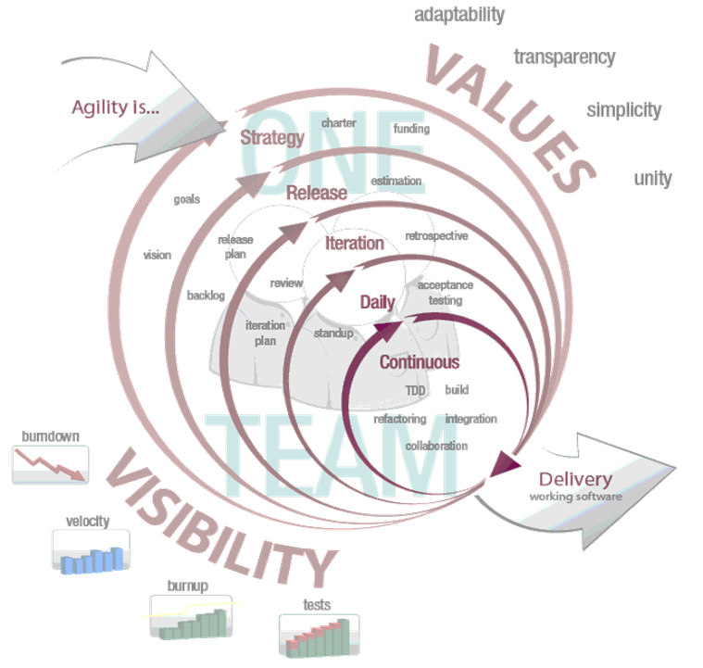
Development models
Agile
“Agile”, the word has been applied around 2001 for building software in a non-traditional way
Features:
low ceremony (fewer procedures, documents)
more effective resource usage
focused on customer and changes
rapid development and feedback
Customer Satisfaction
An approach to building software, in which the overall lifecycle is composed of several iterations in sequence
Each iteration is a self-contained mini-project composed of activities such as requirements analysis, design, programming, and test
The system grows incrementally
CONFIDENTIAL | © 2022 EPAM Systems, Inc.

Slide 4
Development models
Phase 1
Define
Develop
Build
Test
Implement
Phase 2
Define
Develop
Build
Test
Implement
Phase 3
Define
Develop
Build
Test
Implement
Incremental/iterative models (general)
CONFIDENTIAL | © 2022 EPAM Systems, Inc.

Slide 5
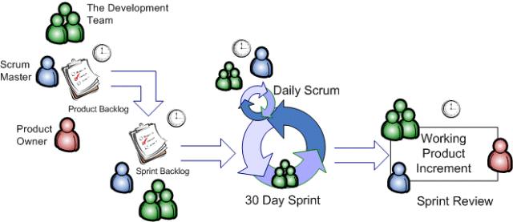
Development models
The scrum method overview
CONFIDENTIAL | © 2022 EPAM Systems, Inc.

Slide 6
DoR and DoD
Definition of Ready:
These are the criteria that the Product Backlog Items must meet to be planned for the upcoming Sprints. For example, “Performance criteria must be written for the task.”
Definition of Done:
DoD is a checklist that helps you to acknowledge that the feature is finalized. For example, “The related unit/service and UI tests should be implemented.”
CONFIDENTIAL | © 2022 EPAM Systems, Inc.

Slide 7
Tools

Slide 8
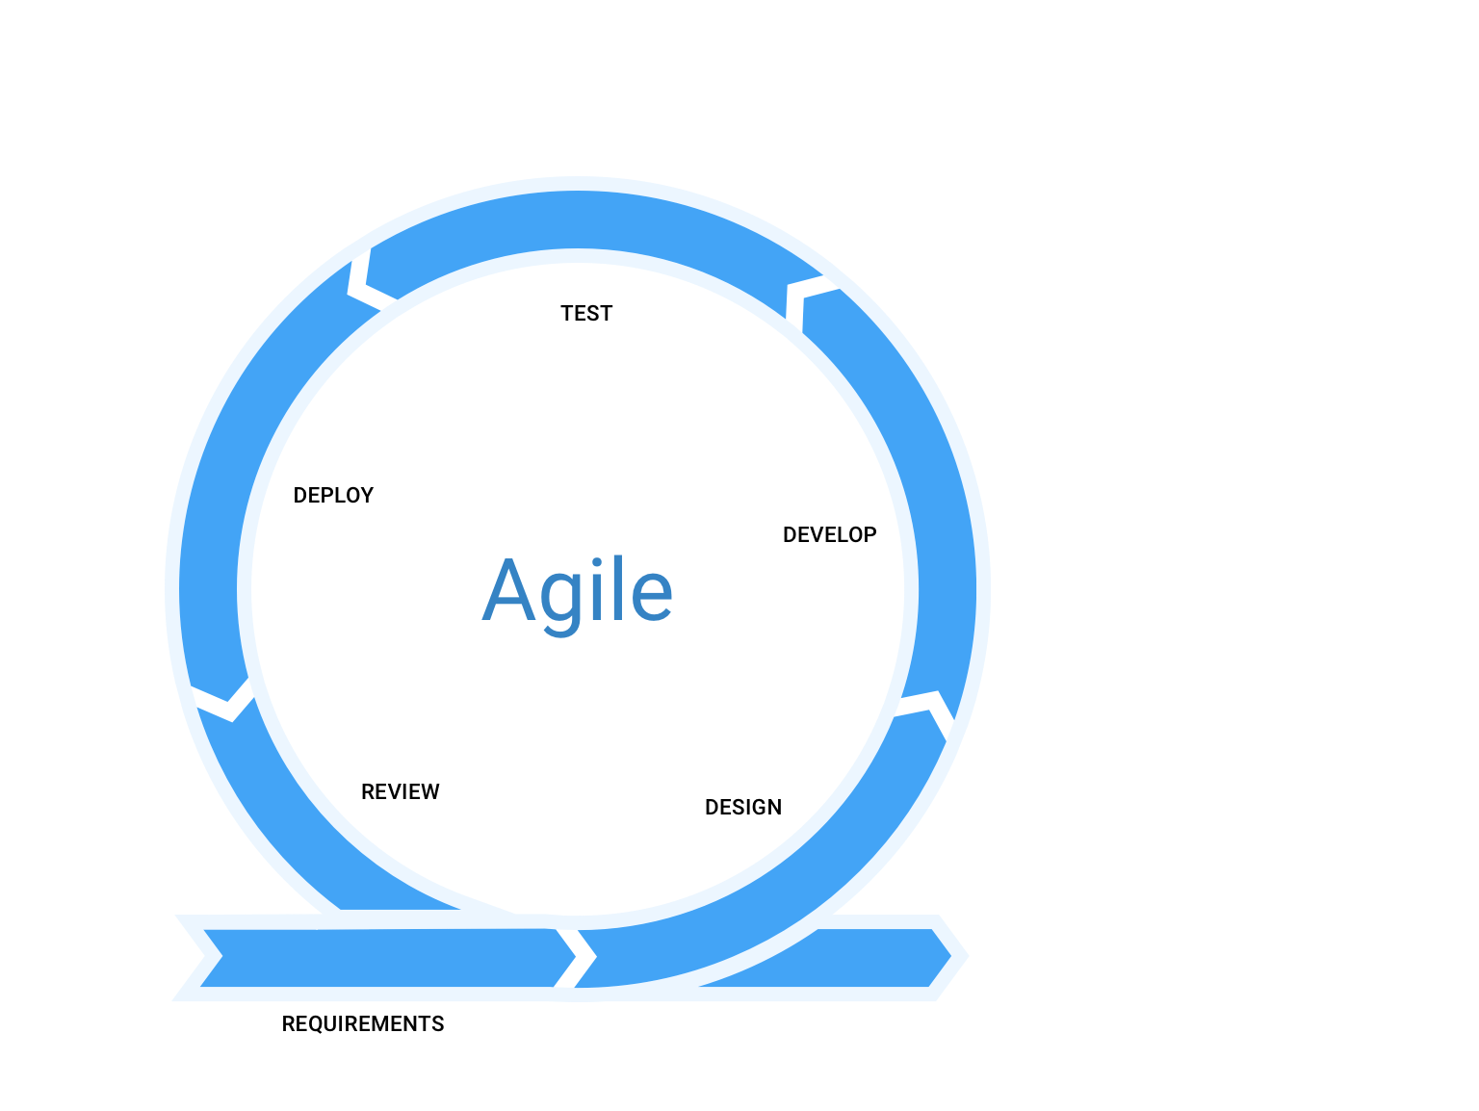
What tools we may need?
Every part of the iteration is aided by tools
Planning/Requirement management/Review/Collaboration
PM systems - Jira, Miro
RQ management systems – Jira, Jama
Documentation tools - Confluence
Design
UX – Figma, InVision
Architectural – Draw.io, Confluence
Development/Deployment
IDE – Visual Studio, Webstorm
CI – Bamboo CI, Jenkins
Test
Test management – qTest, Jama
Perf test – Jmeter, Load Runner
Web testing – Dev tools, Screenpresso, browser extensions

Slide 9
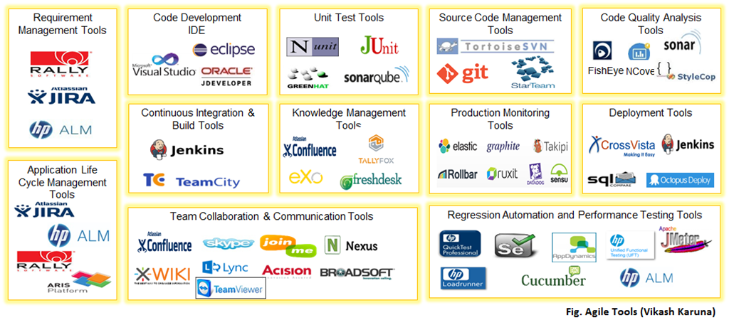
What else we may need?
CONFIDENTIAL | © 2022 EPAM Systems, Inc.

Slide 10
Planning, Requirement Management, Review

Slide 11
Requirement management
Requirements management is the process of documenting, analyzing, tracing, prioritizing and agreeing on requirements and then controlling change and communicating to relevant stakeholders. It is a continuous process throughout a project. A requirement is a capability to which a project outcome (product or service) should conform.
In today’s world of development, it becomes utterly necessary to track changes in the requirement at every step, automatically. Audit trail of requirements is done more efficiently with the involvement of tools.
CONFIDENTIAL | © 2022 EPAM Systems, Inc.

Slide 12
How the tools work?
Miro – work management tool which helps collaboration
It is like a virtual blackboard with a lot of features
Integrated Jira support, with synchronized tickets
Integrated planning poker tool
Integrated retrospective tool
Can be edited by multiple people at the same time
CONFIDENTIAL | © 2022 EPAM Systems, Inc.

Slide 13
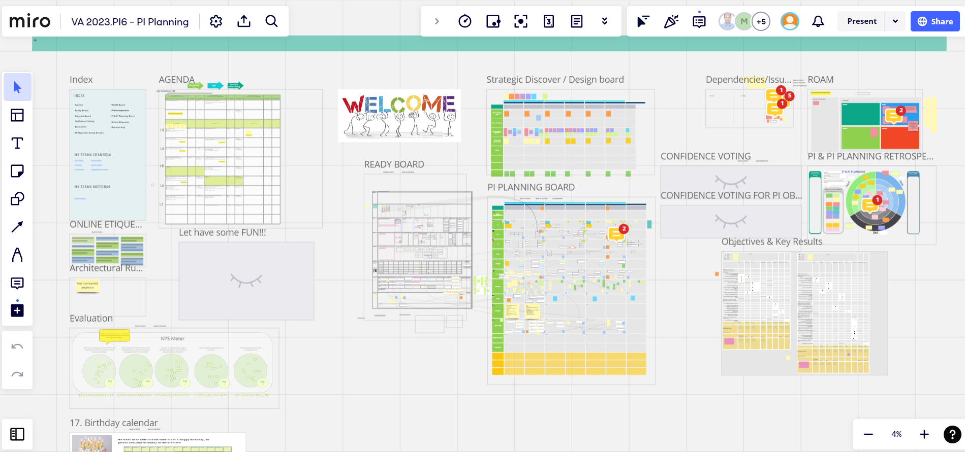
How the tools work?
CONFIDENTIAL | © 2022 EPAM Systems, Inc.

Slide 14
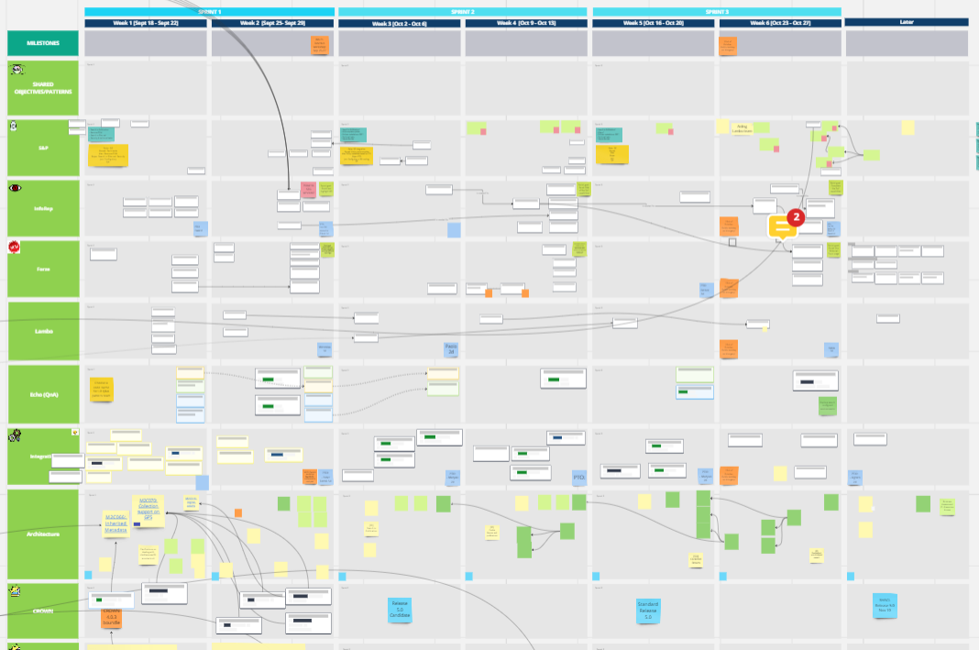
How the tools work?
CONFIDENTIAL | © 2022 EPAM Systems, Inc.

Slide 15
How the tools work?
Jira – ticket management system, highly customisable
Has features which support Agile methodologies
Product backlog, with the option to prioritize
Sprint management (Sprint backlog and Sprint is an entity in the tool)
Generated sprint report with Burndown charts
Dashboards can be created to monitor the progress
Kanban board
Supports release management
RQ can be stored in specific tickets
Custom workflows can be created which matches the iterative process
CONFIDENTIAL | © 2022 EPAM Systems, Inc.

Slide 16
How the tools work?
Confluence – documentation tool
Integrated with Jira (same company)
It is like the own Knowledge Base / Wikipedia of the project
It supports versioning
Documents can be edited by multiple people at the same time
Has privacy settings
It is good for Test Plan/Strategy, DoR/DoD, Decision Registries, Reports (Sprint report, Test Report), Process description, team description, even tracking vacations ☺
CONFIDENTIAL | © 2022 EPAM Systems, Inc.

Slide 17
How the tools work?
Other collaboration, communication tools
MS Teams
Office 365 (Word, Excel, PowerPoint, OneNote)
CONFIDENTIAL | © 2022 EPAM Systems, Inc.

Slide 18
Jira basics

Slide 19

Atlassian Jira
“Jira Software is built for every member of your software team to plan, track, and release great software.”
HIGHLY CUSTOMISABLE – every aspect of the tool that will be shown on the next slides can be customised
Plan: Create user stories and issues, plan sprints, and distribute tasks across your software team.
Track: Prioritize and discuss your team’s work in full context with complete visibility.
Release: Ship with confidence and sanity knowing the information you have is always up-to-date.
Report: Improve team performance based on real-time, visual data that your team can put to use.
CONFIDENTIAL | © 2022 EPAM Systems, Inc.

Slide 20
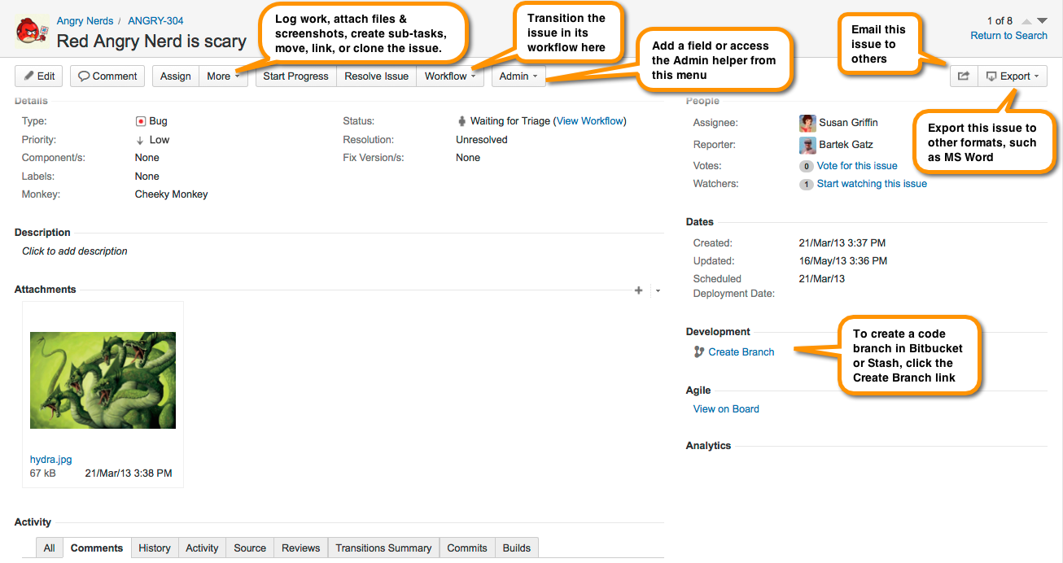
Key terms to know
Tickets: A Jira ticket' refers to a single work item of any type or size that is tracked from creation to completion.
CONFIDENTIAL | © 2022 EPAM Systems, Inc.
Notes:
Other commonly used terms for 'tickets’ are 'requests', 'issues' or 'tasks'.

Slide 21
Key terms to know
Main ticket types
EPIC – describes a bigger chunk of feature (e.g. Homepage of a webshop)
User Story – describes a single feature (e.g. Header, Footer, On sale, Shopping chart)
Task – describes a simple action to be completed, smaller than a User Story and has its own scope (e.g. Clean-up the User DB, Refactor the Header functionality)
Defect/Issue/Bug – describes a bug with steps to reproduce, actual result, expected result, attachment, etc.
CONFIDENTIAL | © 2022 EPAM Systems, Inc.
Notes:
Other commonly used terms for 'tickets’ are 'requests', 'issues' or 'tasks'.

Slide 22
Key terms to know
Main ticket types
Sub-task – a task which is part of a main ticket (US, Task, Defect).
It cannot exist on its own, inherits some values (e.g. sprint) from the main ticket
It is useful if you would like to split the main ticket, so the sub-tasks can be tracked separately
Other
Improvement
Change request
Spike
etc
CONFIDENTIAL | © 2022 EPAM Systems, Inc.
Notes:
Other commonly used terms for 'tickets’ are 'requests', 'issues' or 'tasks'.

Slide 23
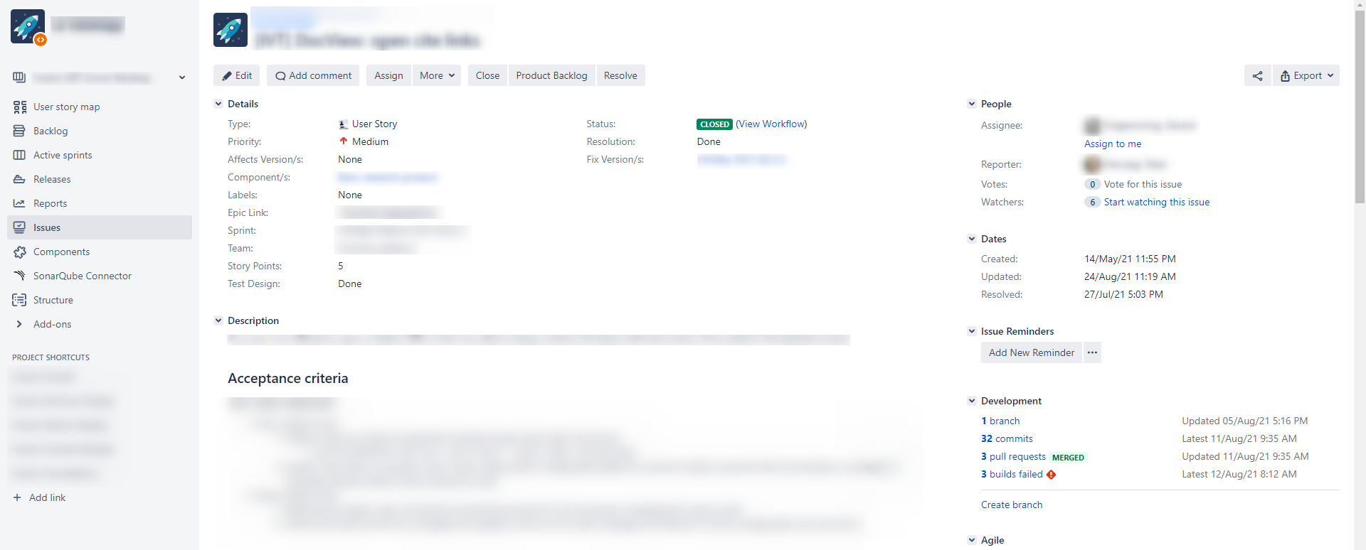
User Story from real life
CONFIDENTIAL | © 2022 EPAM Systems, Inc.
Notes:
Other commonly used terms for 'tickets’ are 'requests', 'issues' or 'tasks'.

Slide 24
Jira advanced

Slide 25
Projects
A project is, quite simply, a collection of issues that are held together by purpose or context.
For example, a JIRA project could be:
a software development project
a marketing campaign
a helpdesk system
a leave request management system
Every issue belongs to a project. Each project has a name (e.g. Website Issues) and a key (e.g. WEB). The project key becomes the first part of that project's issue keys, e.g. WEB-101, WEB-102
CONFIDENTIAL | © 2022 EPAM Systems, Inc.
Notes:
Tickets grouped into projects can be configured in a variety of ways, ranging from visibility restrictions to available workflows. Jira Software projects are flexible working spaces that allow you to group like issues by team, business unit, product, or stream of work. Projects don't need to be tied to the same delivery date.

Slide 26
Statuses
Different statuses are used to indicate the progress of a project like To do, InProgress, Open, Closed, ReOpened, and Resolved.
Likewise, you have resolutions and priorities, in resolution it again tells about the progress of issue like Fixed, Won't fix, Duplicate, Incomplete, Cannot reproduce, Done
You can set also the priorities of the issue whether an issue is critical, major, minor, blocker and Trivial.
CONFIDENTIAL | © 2022 EPAM Systems, Inc.

Slide 27
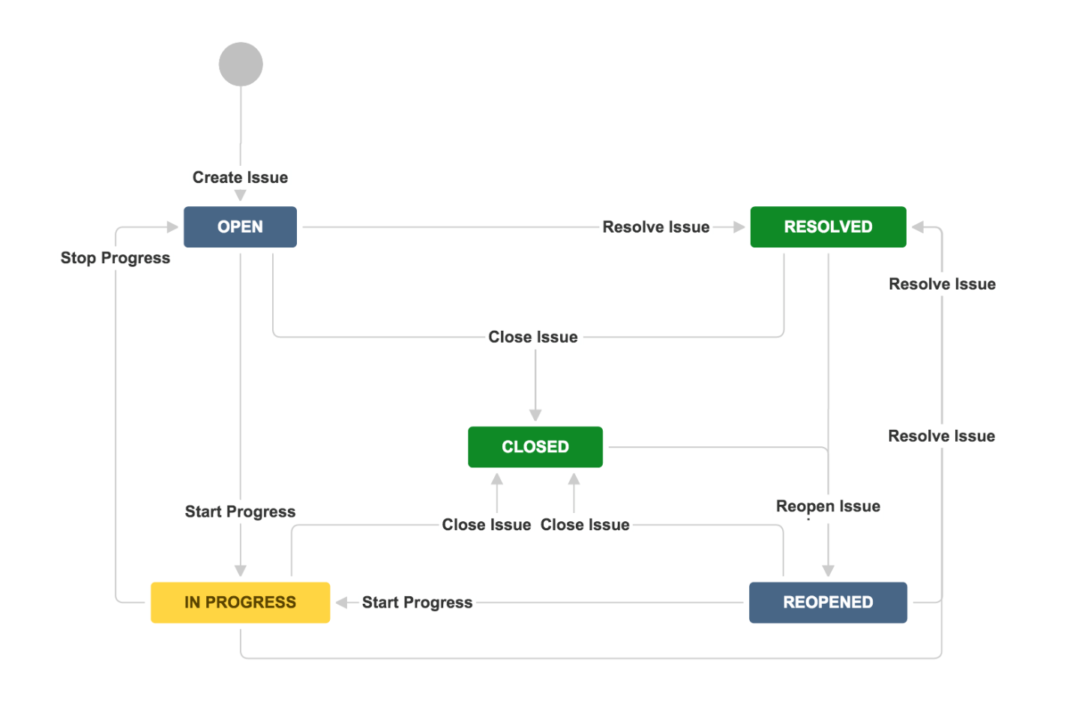
workflows
Represent the sequential path an issues takes from creation to completion.
A basic workflow might look something like this:
CONFIDENTIAL | © 2022 EPAM Systems, Inc.

Slide 28
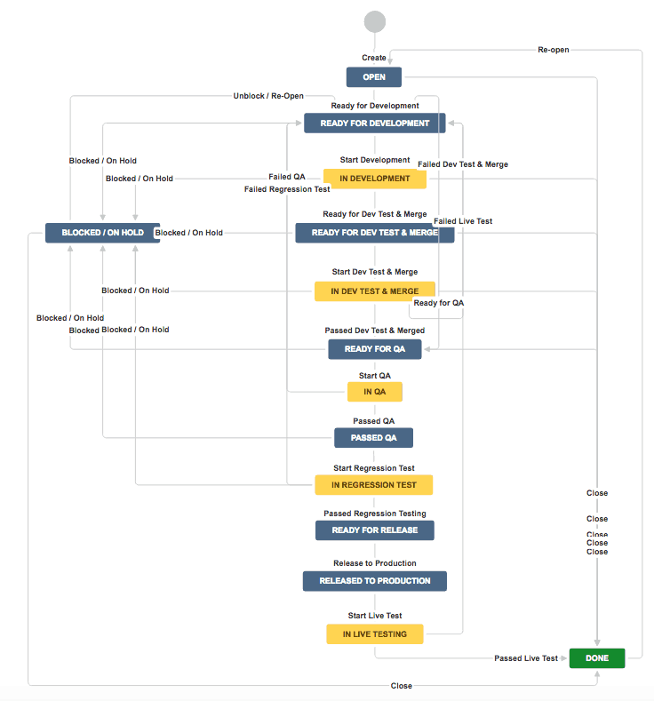
Not so effective workflow
CONFIDENTIAL | © 2022 EPAM Systems, Inc.

Slide 29
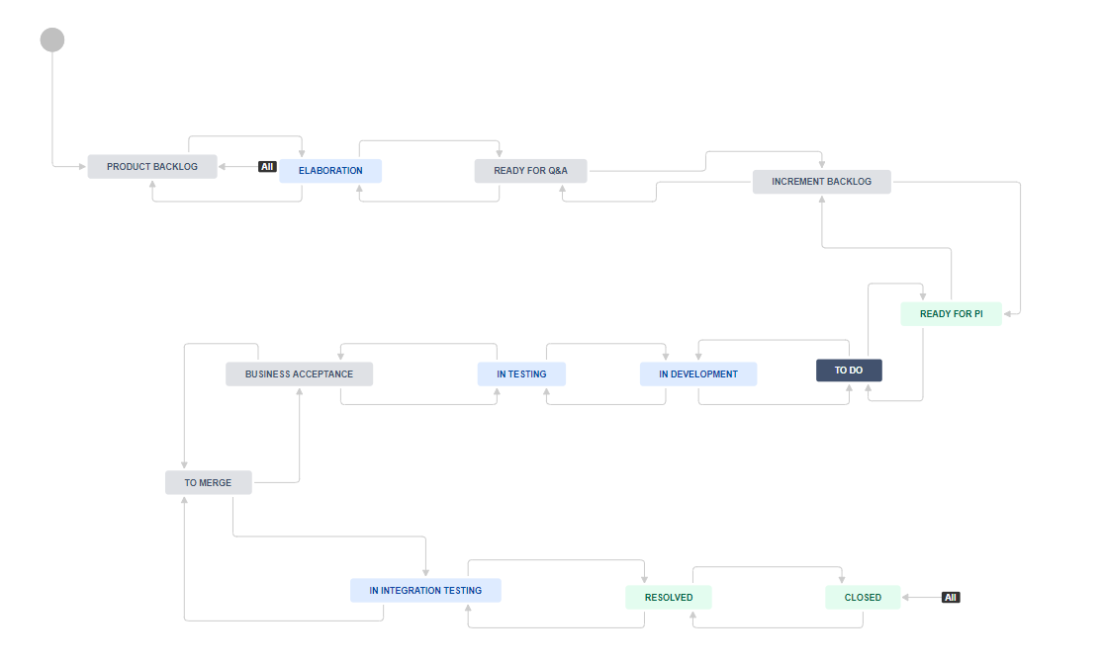
A Workflow from the real life
CONFIDENTIAL | © 2022 EPAM Systems, Inc.

Slide 30
Kanban board and SCRUM board in Jira
Both are used to track our work through the tickets
Kanban board has 2 side columns (Backlog, Done) which can have unlimited tickets, every other column has a limit
Kanban board tracks the whole project from start to finish
SCRUM board usually tracks an ongoing sprint, and its content always reflects the actual sprint
SCRUM board has no limit for the columns, since the team committed to the sprint and they should be able to deliver
CONFIDENTIAL | © 2022 EPAM Systems, Inc.

Slide 31
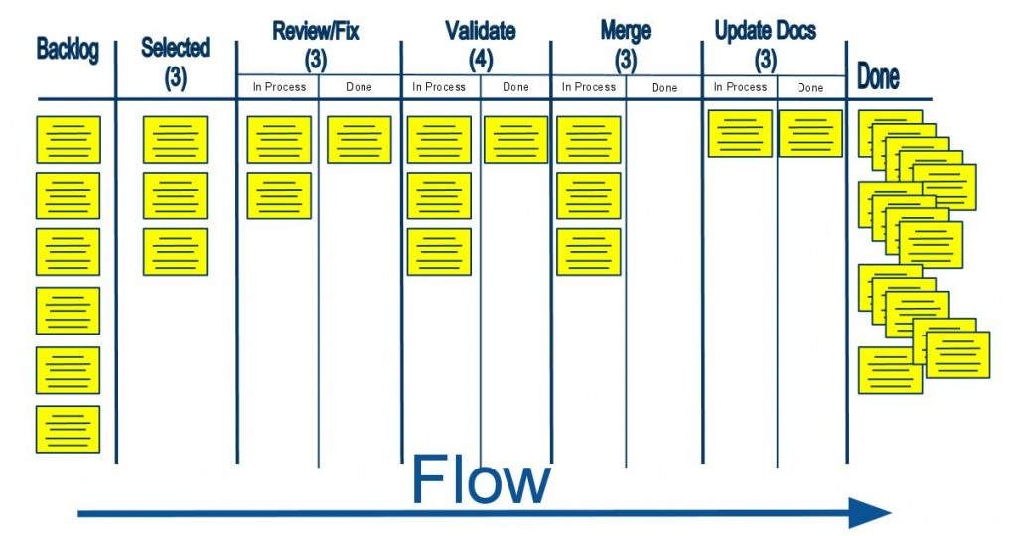
Key terms and concepts on scrum board
CONFIDENTIAL | © 2022 EPAM Systems, Inc.

Slide 32
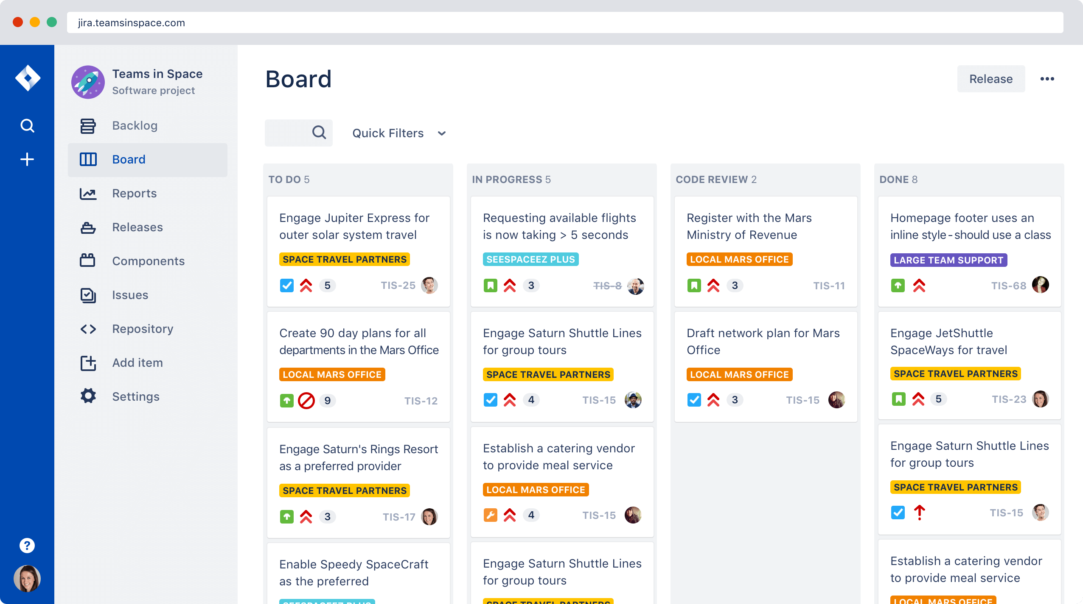
CONFIDENTIAL | © 2022 EPAM Systems, Inc.

Slide 33
Velocity
Velocity is the average amount of work a scrum team completes during a sprint, measured in either story points or hours, and is very useful for forecasting.
The product owner can use velocity to predict how quickly a team can work through the backlog, because the report tracks the forecasted and completed work over several iterations–the more iterations, the more accurate the forecast.
It's important to monitor how velocity evolves over time. New teams can expect to see an increase in velocity as the team optimizes relationships and the work process.
It is important to include the variables to the forecast (e.g. Team changes, PTOs, trainings, etc.)
CONFIDENTIAL | © 2022 EPAM Systems, Inc.

Slide 34
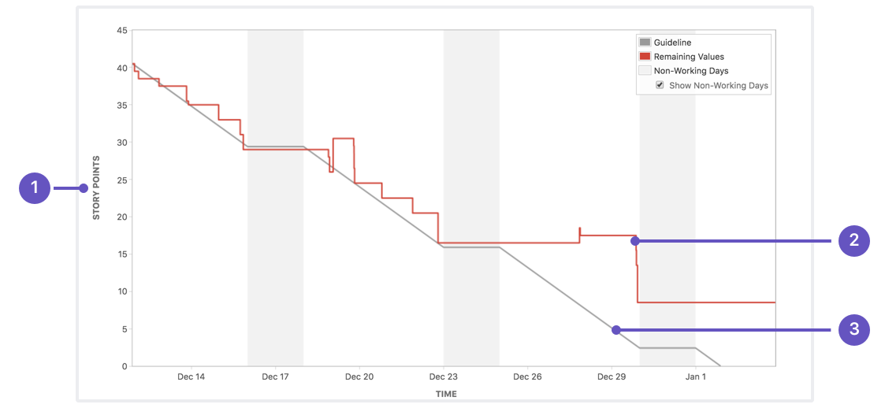
Sprint burndown
A sprint burndown report then tracks the completion of work throughout the sprint.
CONFIDENTIAL | © 2022 EPAM Systems, Inc.
Notes:
The x-axis represents time, and the y-axis refers to the amount of work left to complete, measured in either story points or hours. The goal is to have all the forecasted work completed by the end of the sprint.
1) Estimation statistic: The vertical axis represents the estimation statistic that you've selected.
2) Remaining values: The red line represents the total amount of work left in the sprint, according to your team's estimates.
3) Guideline: The grey line shows an approximation of where your team should be, assuming linear progress. If the red line is below this line, congratulations - your team's on track to completing all their work by the end of the sprint. This isn't foolproof though; it's just another piece of information to use while monitoring team progress.

Slide 35
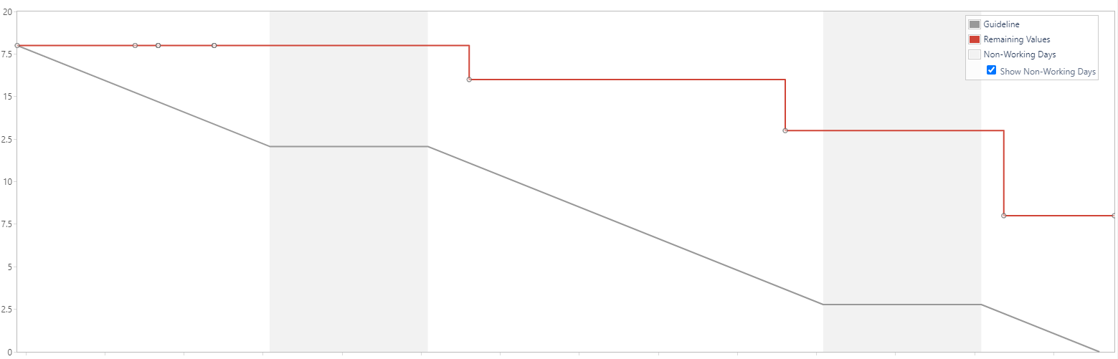
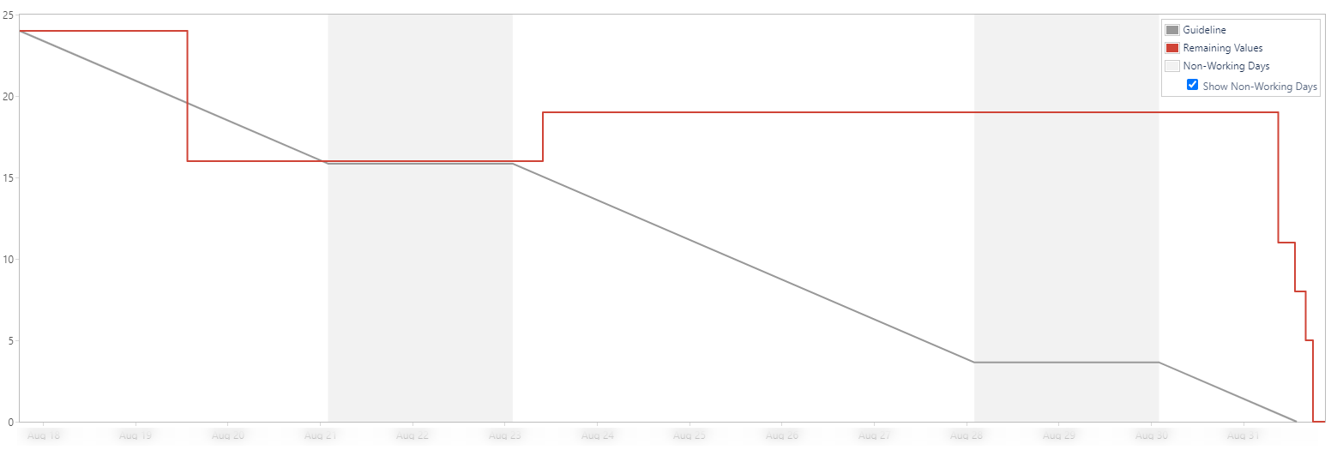
Sprint burndown- from Real life
CONFIDENTIAL | © 2022 EPAM Systems, Inc.
Notes:
The x-axis represents time, and the y-axis refers to the amount of work left to complete, measured in either story points or hours. The goal is to have all the forecasted work completed by the end of the sprint.
1) Estimation statistic: The vertical axis represents the estimation statistic that you've selected.
2) Remaining values: The red line represents the total amount of work left in the sprint, according to your team's estimates.
3) Guideline: The grey line shows an approximation of where your team should be, assuming linear progress. If the red line is below this line, congratulations - your team's on track to completing all their work by the end of the sprint. This isn't foolproof though; it's just another piece of information to use while monitoring team progress.

Slide 36
Search in Jira

Slide 37
Search JIRA like a boss with JQL
There are two types of searches in JIRA: simple and advanced.
Simple search uses a set of forms that a user fills in. The advanced search uses JQL (JQL stands for JIRA Query Language).
It’s the most flexible way to search for issues in JIRA and is for everyone: developers, testers, project managers, and even non-technical business users.
A query has three basic parts: fields, operators, and values.
Field - Fields are different types of information in the system. JIRA fields include priority, fixVersion, issue type, date created, etc.
Value - Values are the actual data in the query: v2.3, Bug, 10/21/2014, etc.
Operator - Operators are the heart of the query. They relate the field to the value. Common operators include equals (=), not equals (!=), less than (<), etc.
Keyword - Keywords are specific words in the language that have special meaning. In this post we will be focused on AND and OR.
CONFIDENTIAL | © 2022 EPAM Systems, Inc.

Slide 38
Examples
What issues are blocking or critical in Projects A, B, and C? priority in (Blocker, Critical) AND project in (ProjA, ProjB, ProjC)
What issues are unassigned and have not been updated in the last day? assignee is EMPTY and updatedDate < -1d
which issues got fixed in the last release. project = pwc AND status in (resolved, closed) and fixversion = "Sprint A"
CONFIDENTIAL | © 2022 EPAM Systems, Inc.

Slide 39
Examples
Which bugs John Smith resolved in the PWC project? project = PWC AND status CHANGED FROM "In Progress" TO "Resolved" BY jsmith
Sometimes issues that fail verification or get reopened are of special interest and we want to see why a feature didn't work as intended. To find those bugs it's easy to run this query: status CHANGED FROM "In Progress" TO "Open"
Similarly, to see what issues were in flight during the current week we can use the following JQL: status was ("In Progress") DURING (startofweek(), endofweek())
And at the end of the year it can be nice to see how many issues you resolved during the year. All it takes is a little JQL: resolution changed to "Fixed" by currentUser() during (startOfYear(), endOfYear())
CONFIDENTIAL | © 2022 EPAM Systems, Inc.

Slide 40
Thank you for the attention

